Slide 1
Lesson 2 Introduction to Python
Objectives and Outcomes
Objectives
Know what Python is and some of the applications it is used for.
Understand how to run a simple Python program in Interactive and Script mode.
Understand what a syntax error is and how to interpret an error message.
Outcomes
Be able to run a simple Python program in Interactive and Script mode using the print function.
Be able to problem solve and correct syntax errors.
Be able to explain how you created your programs in Script mode.
Keywords:
Print
Interactive mode
Syntax error

Slide 2
Review the purpose of pseudocode and how it translates into programming code.
Discussion (5 mins):
Describe pseudocode in your own words.

Slide 3

Simple Pseudocode:
START
PRINT “Hello, World!”
END

Slide 4
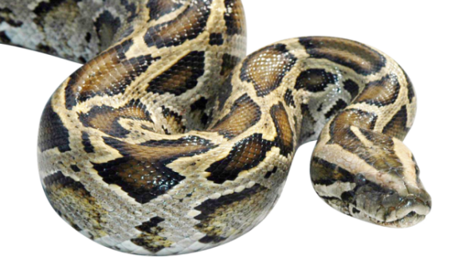
LEARNING TASK - Python What is it?
Coding means writing instructions for a computer to perform a task in a form that the computer can understand. There are many programming languages including HTML, C++, Scratch & Kodu.
Python:
In 1989 the Python programming language was written. It is a typed computer language, where short programs can be created relatively easily.
It is used by many large organisations including:
Nokia
NASA
Paint Shop Pro
Google’s Search Engine
YouTube

Slide 5
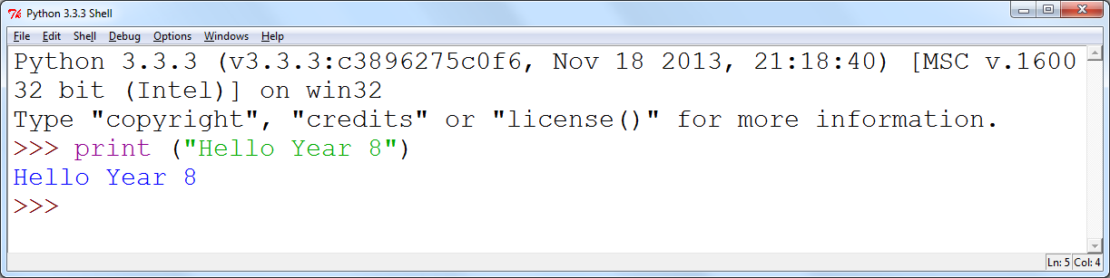
LEARNING TASK - IDLE What is it?
IDLE:
IDLE (Integrated DeveLopment Environment) is an application which understands Python code and helps you to get your coding right.
It is what we will use to create, save and run the programs.
Python = is a computer based typed language
IDLE = is the software we use to create programs using Python

Slide 6
Install Python

Slide 7
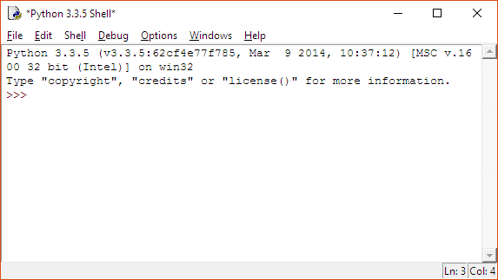
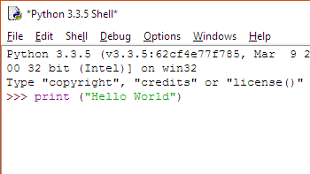
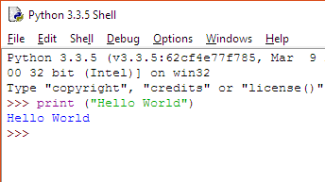
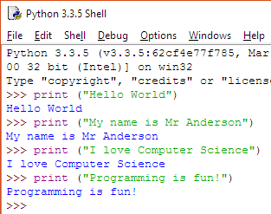
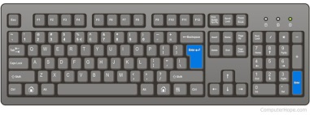
COMPUTER TASK - print (“Hello World”) Task 1 - Create your first program
1
2
Open IDLE and look for the chevrons >>>
Type:
print (“Hello World”)
3
E
See what other print statements you can create using the same technique as you did with “Hello World”
Now press Enter on the keyboard

Slide 8
PAIRED TASK - Syntax Errors Task 2 - Spot the errors
Syntax = the structure of statements in a computer language.
Error = a mistake.
Syntax Error = a mistake with your computer language.
Below there are four lines of code that involve the print statement. Each line has a syntax error.
Discuss with a partner what mistakes have been made on each line of code.
Code | Mistake
primt ("Hello World!") | print is spelt incorrectly
Print ("Hello World!")
print (Hello World!)
print "Hello World!"

Slide 9

Output

Slide 10
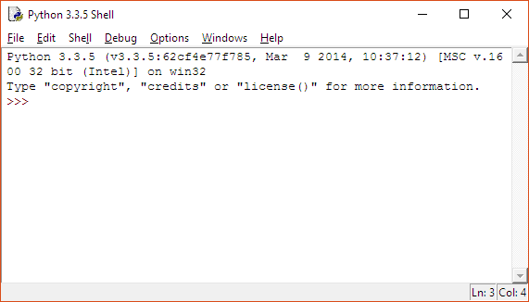
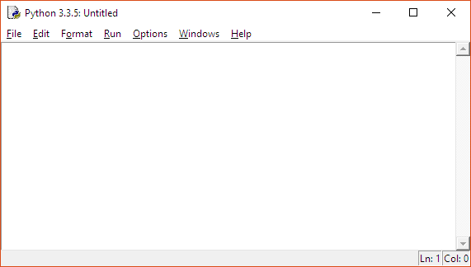
LEARNING TASK - Interactive & Script mode What is the difference?
Interactive mode:
Performs one line of code at a time. As soon as you press Enter, Interactive mode runs that one line immediately. Interactive mode is also the platform where programs in Script mode run.
Script mode:
You can write many lines of code and you can save your work. The program you create will not run until you tell it to. More useful that Interactive mode.
Interactive mode:
Writing at the top
Chevrons >>>
Shell is at the top
Always the first to appear when IDLE is opened
Script mode:
Completely empty
File name called Untitled
Shell tab replaced with Format
Debug replaced with Run

Slide 11
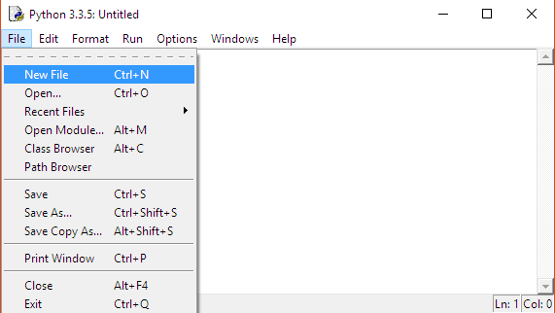
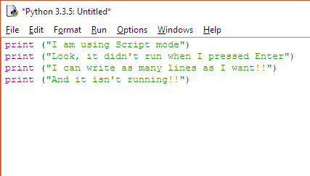
COMPUTER TASK - print, print & more print Task 3 - Using Script mode
1
2
Open IDLE and select File
Then select New File, or use the shortcut; Ctrl + N
3
4
You will now see Script mode.
Write a few lines of code
in Script mode using the print function. We will save in the next Task.

Slide 12
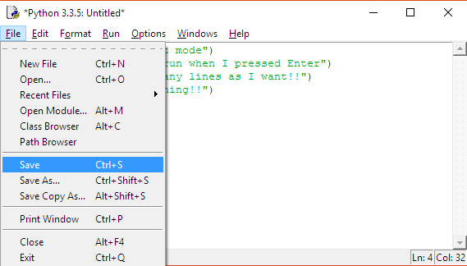
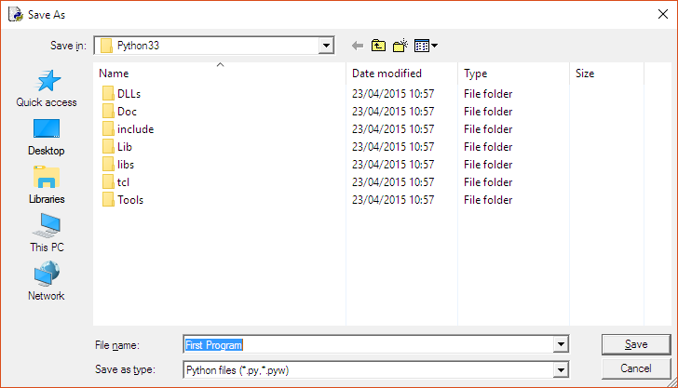
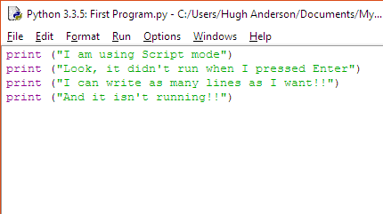
COMPUTER TASK - Let‘s save Task 4 - Learning to save the program
1
2
Create a new folder in your onedrive area called (403IT – Programming)
Then select File.
Then select Save, or use the shortcut; Ctrl + S
3
Call the file First Program and save in your new Python folder.
4
You will now see the new file name (First Program in this case) at the top.

Slide 13
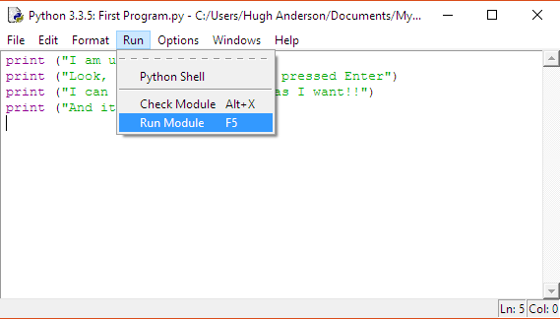
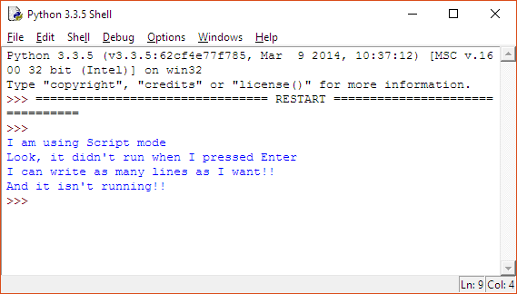
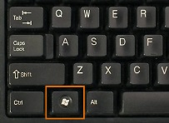
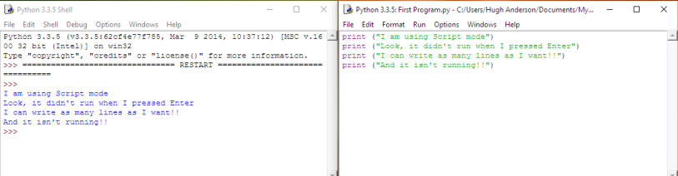
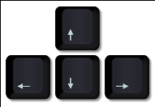
COMPUTER TASK - Let‘s run Task 5 - Learning to run the program
1
2
To run the program, select Run, then Run Module, or use the shortcut; F5.
This will open Interactive mode and run your code.
+
3
4
It is good practise to split your screen, so you’ve got interactive mode on one side and script mode on the other.
Use the Windows Key and Directional Arrows to achieve this.
Ask if you need me to demonstrate the process.

Slide 14


COMPUTER TASK - Creating complex code Task 6 - CHALLENGE TIME!
Now that you know how to open IDLE and open Script Mode, select a challenge below and complete it using Script mode. Don’t forget to save your program and run it, to make sure it works.
LEMON AND HERB CHALLENGE
Create a program in script mode that outputs the below message. Save it as “I Love Python”.
“I love Python and right now I’m learning to program!”
MILD CHALLENGE
Create a program in script mode that outputs the below message. Save it as “Stay Calm”.
“STAY” “CALM” “AND” “LEARN” “PYTHON” (note: each word should be on a new line!).
HOT CHALLENGE
Create a program in script mode that outputs the following message. Save it as “About Me”.
“My name is: ” “My surname is: ” (note: each sentence should be separated by a blank line!).

Slide 15
Variables
Now that you've completed the Hot Challenge, you’ve seen how to use print() to display information.
But imagine you wanted to change your name or surname in the program multiple times. Wouldn’t it be easier if you didn’t have to rewrite the same lines every time?
That’s where variables come in!

Slide 16
What Are Variables?
A variable is like a container where I can store information, such as my name or age.
Instead of typing my name directly in the print() function, I can store it in a variable and use it whenever I need it.

Slide 17
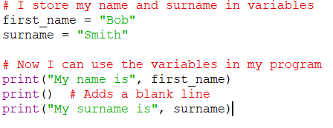
Let Me Show You How:

Slide 18
I used first_name = "Bob" to store "Bob" in the variable first_name.
When I type print("My name is", first_name), the program replaces first_name with "Bob" when it runs.
I can change "Bob" to "Alice" in one place, and the program will still work everywhere it uses first_name.

Slide 19
Worksheet

Slide 20
What types of information do you think Python can store in variables?

Slide 21
What types of information do you think Python can store in variables?
Explain the four main data types in Python:
String (str):
Integer (int):
Float (float):
Boolean (bool):

Slide 22
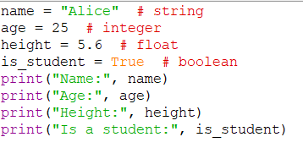
Example

Slide 23
Working_with_Variables_and_Data_Types_Worksheet

